Slide 1

Corporate Strategy & Analytics
Proactive Churn Management for High-Value Subscribers
A Data-Driven Proof of Concept (PoC) Proposal for Indian Telecom Companies
Presented by
Adityabaan Tripathy
SRM Institute of Science and Technology, India
Program : GCI World 2026, Matsuo-Iwasawa Laboratory at the University of Tokyo

Slide 2
Agenda
Navigating Our Path from Raw Historical Data to Quantifiable Revenue Protection
01
02
03
The Market Challenge & Our Business Idea
Translating Behavior into Predictive Machine Learning Models
Strategic Retention Proposals & Projected Financial ROI
Evaluate economic and behavioral forces driving subscriber attrition, and outline our strategic business solution
Outline targeted business interventions and their direct, simulated impact on our bottom line
Examine how our predictive engine decodes raw data into clear early-warning signals for proactive intervention
This presentation demonstrates how advanced analytics transforms customer retention from a reactive cost center into a proactive revenue protection engine

Slide 3
Strategic Framework
Shifting from Reactive Marketing to Proactive, ROI-Driven Retention
Situation
Problem
Business Idea
Intense price war in Indian telecom landscape with Mobile Number Portability (MNP) being completely frictionless
Customer Acquisition Cost (CAC) is 5-25x higher than retention costs, making churn extraordinarily expensive
Deploy an early-warning Machine Learning engine to intercept flight-risk customers before they switch providers
Data consumption is massive, yet Average Revenue Per User (ARPU) remains severely compressed
Silent customer churn is aggressively draining operating margins without visible warning signs
Enable highly targeted, ROI-positive retention campaigns that protect revenue while minimizing waste
Current reactive marketing blasts are too expensive, inefficient, and target the wrong subscribers
Market saturation forces operators to compete primarily on price, eroding operating margins
Transform customer retention from reactive firefighting into proactive, data-driven revenue protection
Customers can switch providers seamlessly with zero friction
Each lost high-value subscriber costs 5-25x more to replace
Move from chasing lost customers to preventing departure
The Strategic Imperative: Stop reacting to churn. Start predicting and preventing it.

Slide 4
The Asset
Utilizing Our Historical Customer Footprint to Build a Unified Customer 360 Profile
Customer Profile Data
Captures baseline, long-term indicators
100K
Account Longevity: Tenure duration and loyalty history
Equipment Age: Handset lifecycle and upgrade readiness
Active Customer Accounts
Handset Pricing: Device value and subsidy exposure
Demographics: Customer segmentation characteristics
Analyzed over a multi-month observation window to capture comprehensive behavioral patterns and lifecycle stages
Real-Time Behavior Data
Tracks fluid, monthly metrics
Unified Data Architecture: Merging behavioral and profile records creates a multi-dimensional view of each subscriber
Mean Revenue: Monthly ARPU and billing trends
Minutes of Usage (MOU): Voice and data consumption velocity
Overage Charges: Bill shock indicators and plan fit
Network Service Issues: Quality of experience complaints

Slide 5
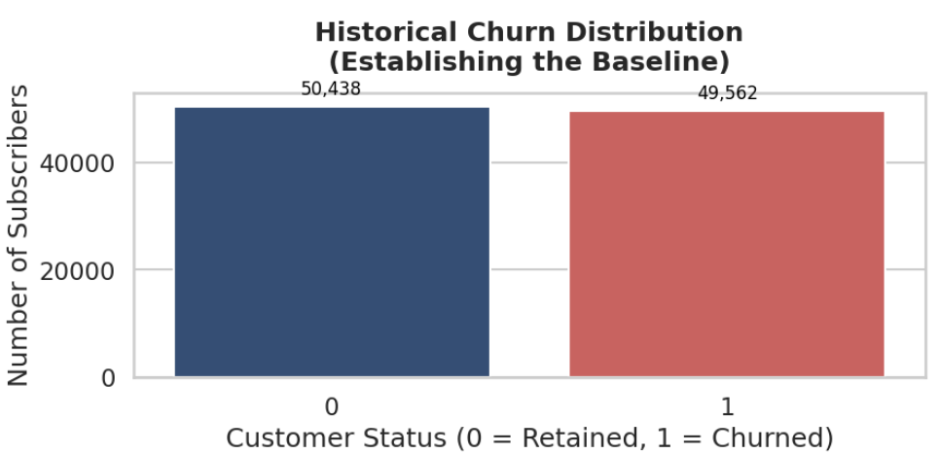
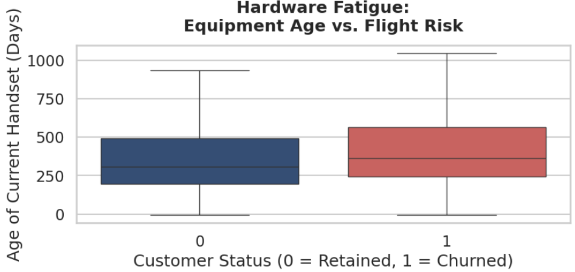
The Evidence
Exploratory Analysis Uncovers Visible Behavioral Predictors Long Before Churn Occurs
Historical Churn Distribution
Equipment Age vs. Flight Risk
Strategic Insight
Churning customers operate on handsets that are significantly older, leaving them highly vulnerable to competitor upgrade promotions. This pattern reveals a clear intervention point: proactive hardware renewal offers can intercept flight-risk subscribers before they engage with competitor marketing.

Slide 6
The Predictive Engine
Overcoming the Accuracy Paradox by Calibrating Our AI to Optimize for Profitability
Raw Customer Records
Feature Engineering
SMOTE Balancing
Dynamic Threshold Optimizer
100K unified accounts with behavioral and profile data
Financial ratios and domain-specific metrics
Synthetic oversampling for minority class detection
Calibrated for business value, not just accuracy
The Accuracy Paradox
Our Solution
Standard models achieve high "paper accuracy" by predicting that most customers will stay—because most do.
We implemented an optimized XGBoost engine combined with SMOTE data-balancing to force the model to pay attention to minority churn signals.
This creates a dangerous illusion of performance while delivering zero business value, as the model never identifies actual flight risks.
The Dynamic Threshold Optimizer scans the entire risk spectrum, maximizing true risk identification rather than playing it safe.
The result: wasted retention budgets on false alarms while real churners slip away undetected.
This ensures budget is spent only on subscribers genuinely preparing to leave, not on false alarms.
Business-Calibrated AI: Optimized for profit protection, not just statistical accuracy

Slide 7
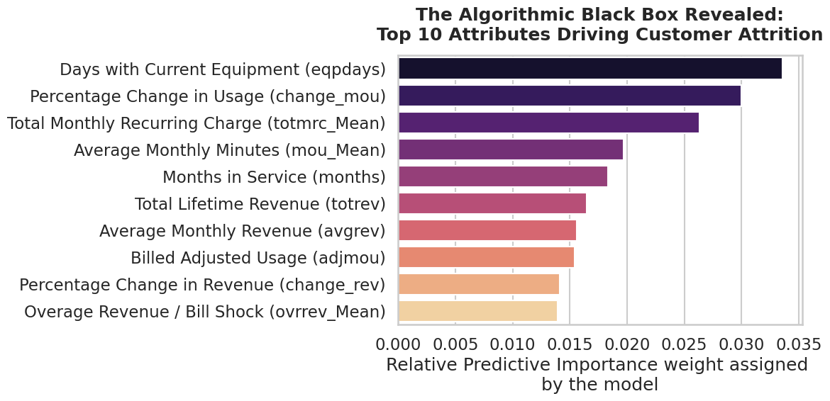
The Triggers
The AI Identifies Equipment Age and Recent Bill Shock as the Primary Triggers of Attrition
Top 10 Attributes Driving Customer Attrition
Algorithm Insights
The algorithm bypasses human intuition, analyzing complex behavioral interactions invisible to traditional analysis.
It highlights that long equipment lifecycles combined with sudden drops in monthly usage velocity are the ultimate signals of an inactive subscriber.
Engineered metrics like "Cost Per Minute" also rank in the top tier, revealing plan misalignment.
Critical Finding
When a user's phone gets old and their usage drops, they are silently preparing to exit. These are actionable, early-warning signals.

Slide 8
Proactive Retention
Deploying Automated, Precision Interventions to the Highest-Risk Customer Cohorts
Strategic Pillar 1
Strategic Pillar 2
Targeted Hardware Renewals
Bill Shock & Plan Rightsizing
Action
Action
Isolate subscribers in the highest-risk decile who have equipment lifecycles exceeding 12 months. These customers show the strongest correlation between hardware age and flight probability.
Identify high-value users whose risk scores are driven by high overage charges and sudden drops in voice/data usage. These subscribers are experiencing bill shock and plan misalignment.
Incentive
Incentive
Push a proactive, personalized app notification offering an attractive, subsidized handset upgrade paired with a contract extension. Transform tech fatigue into loyalty.
Have customer care proactively reach out to offer right-sized, unlimited tier upgrades, waiving current overages to restore brand loyalty and prevent silent departure.
Expected Impact: 15-25% reduction in hardware-driven churn
Expected Impact: 20-30% reduction in bill-shock-driven churn
Automated Execution: Both pillars are triggered automatically by the AI engine when risk thresholds are breached, ensuring zero-delay intervention

Slide 9
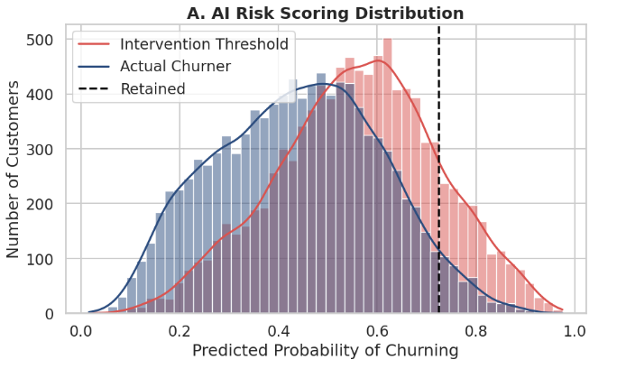
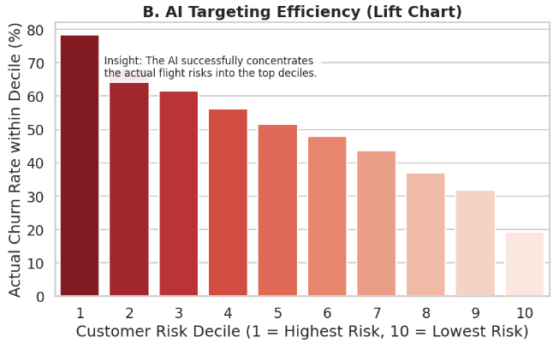
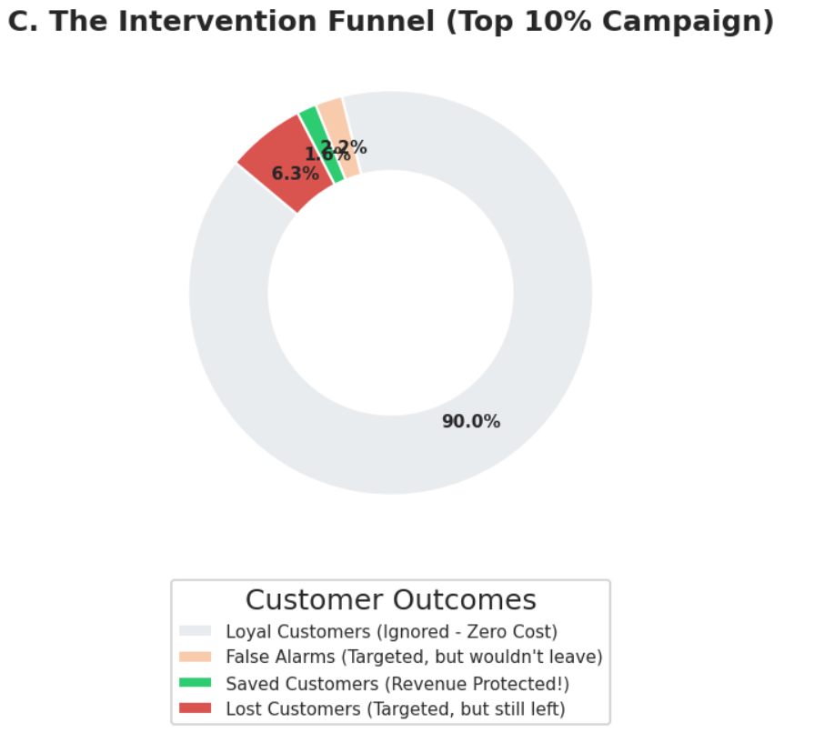
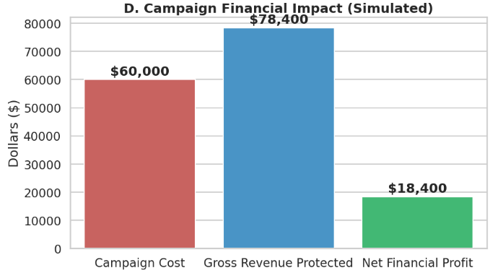
The ROI
Predictive Targeting Restricts Spend to Vulnerable Tiers, Maximizing Financial ROI
$18,400.00
Performance Dashboard
Simulated Campaign Net Profit
High-value retention campaigns driven by this AI engine yield an optimized return on investment, converting a historical cost center into a direct revenue protector.
Financial Logic
Focus spend on top 10% riskiest users
Avoid wasting capital on loyal customers
Gross revenue protected outweighs incentive costs
Massive net profit secured for operations

Slide 10
Executive Conclusion
Translating Complex Data into a Predictive and Profitable Business Engine
Diagnosing the Root Cause
We moved beyond surface-level metrics to pinpoint hardware fatigue and sudden usage drops as the primary behavioral triggers for churn. Our exploratory analysis revealed that customers operating on older handsets with declining usage velocity are silently preparing to exit—providing clear, actionable early-warning signals.
Empowering the Algorithm
By engineering domain-specific financial signals and utilizing SMOTE to balance the data, we trained an XGBoost model optimized specifically for the complexities of human behavior. This approach overcomes the accuracy paradox, ensuring the model identifies true flight risks rather than playing it safe with statistically correct but commercially useless predictions.
Calibrating for Profit
Instead of accepting standard "safe" accuracy, we dynamically optimized the decision threshold to actively isolate the top 10% of high-value flight risks. This calibration protects millions in revenue while minimizing campaign costs, transforming customer retention from a reactive expense into a proactive profit center.
The Bottom Line
This Proof of Concept demonstrates that predictive churn management is not a technical exercise—it is a strategic imperative for protecting operating margins in a saturated, price-compressed market.

Slide 11
Supporting Research
Industry Research & Academic References
1
A. Kumar, P. Kakkar, and M. K. Chouhan, “Enhancing Telecom Customer Churn Prediction Using Machine Learning and LSTM for Time-Series Analysis,” 2025 International Conference in Advances in Power, Signal, and Information Technology (APSIT), pp. 1–7, May 2025, doi: 10.1109/apsit63993.2025.11086177.
2
R. P. Bhatta, K. D. Bhatt, N. Pal, and M. R. Pant, “XGBoost Ensemble Model for Churn Prediction in Telecom: A Machine Learning Framework,” NPRC Journal of Multidisciplinary Research, vol. 3, no. 4, pp. 171–189, Apr. 2026, doi: 10.3126/nprcjmr.v3i4.93374.
3
M. Imani, M. Joudaki, A. Beikmohammadi, and H. Arabnia, “Customer Churn Prediction: A Systematic Review of Recent Advances, Trends, and Challenges in Machine Learning and Deep Learning,” Machine Learning and Knowledge Extraction, vol. 7, no. 3, p. 105, Sep. 2025, doi: 10.3390/make7030105.
4
H. A. Rasool, K. K. Aljawaheri, and A. A. M. Karram, “Explainable Customer Churn Prediction in Telecom Using Ensemble Learning and SHAP Analysis,” Mathematical Modelling of Engineering Problems, vol. 12, no. 12, pp. 4373–4386, Dec. 2025, doi: 10.18280/mmep.121226.
5
S. Wu, “Customer Churn Prediction in Telecom Based on Machine Learning,” Highlights in Science, Engineering and Technology, vol. 94, pp. 113–118, Apr. 2024, doi: 10.54097/snc09915.
Methodology Validation: The methodologies applied in this proposal are heavily supported by recent 2024 and 2025 industry research, highlighting XGBoost and advanced Machine Learning techniques as the gold standard for modern telecommunications churn prediction.

Slide 12
Supporting Research
Image References
1
https://www.google.com/url?sa=t&source=web&rct=j&url=https%3A%2F%2Fswarajyamag.com%2Fbusiness%2Fthe-indian-telecom-sector-needs-an-urgent-reorganisation-heres-why&ved=0CBYQjRxqFwoTCJik0suwhJUDFQAAAAAdAAAAABA3&opi=89978449
2
All the other graphs that have been used in this presentation have been taken directly from the output generated in the colab notebook which has been submitted.

